Slide 1
Programming 4 - Intermediate Architecture
and Algorithms
Introduction to Programming Paradigms
Semester 2, 2019

Slide 2
Programming 4
Week 10 was the end of the C++/CLI content
This week and beyond we are going to look into different paradigms
Assignment 1 is due on the 1.11.19 – see me if you can’t make the deadline
Labs are due on the 15.11.19
Assignment 2 is due 22.11.19
I will be active on MS Teams so feel free to ask me questions

Slide 3
Paradigms and Syntax
Construction is built on a series of choices
Paradigm is a method to solve a problem or do a task
Syntax refers to a languages textual features
Notes:
A programming language is built on a series of choices – these choices are primarily paradigms and syntax
A programming paradigm is an approach to solve a problem using a programming language of your choice or a method of using tools and techniques to solve a problem
Programming 1 and 2, you learned C#, Programming 3, you learned Java, Web 2, you learned PHP. These are examples of the imperative paradigm. DB2, you learned SQL, which is an example of the declarative paradigm. We will look more into this soon
Syntax refers to the spelling and grammar of a programming language
Languages of the same paradigm frequently have the same syntactic features for performing the same action. For example, inheritance, Java uses the “extend” keyword and C# and C++ use “:”. The result is always going to be the same, the syntax is different. It looks different to the eye
Each feature implemented in a programming language is clear and deliberately made by the language author
Every language comes with their obvious pros and cons. Some languages were designed to make programs easier to write, some languages were designed to help compilers or interpreters to produce more efficient code, some languages are designed to prevent runtime errors

Slide 4
Programming paradigms
Imperative
Functional
Declarative
Logical
Notes:
The programming paradigm is a broad, abstract model of how programs are constructed
These are the four primary programming paradigms that you should care about – there are less common ones and a huge range of multi-paradigms
There are many programming languages that are multi-paradigm – meaning that it can support features of one or more paradigms
For example, JavaScript is imperative but has functional features such as map, reduce, filter. C# is imperative but has declarative features such as LINQ
Language Integrated Query (LINQ) is a structured query syntax similar to SQL used to retrieve data from different types of data sources such as databases and web services

Slide 5
Imperative
A step by step sequence of instructions
Changes the state of the program
Examples of imperative languages are C#, Java and C++
int total = 0;
int number1 = 5;
int number2 = 10;
int number3 = 15;
total = number1 + number2 + number3;
Notes:
Imperative language uses a sequence of instructions to determine how to reach a certain goal
These instructions change the state of the program as each one is executed in turn

Slide 6
Declarative
Building logic without describing its flow
Examples of declarative languages are HTML, XML and SQL
Notes:
The declarative paradigm focuses on building logic without actually describing its flow
You are saying what without adding how. For example with HTML you use an <img> tag to tell the browser to display an image
You don’t care how it does that. The implementation details are left to the system or for example your compiler

Slide 7
Functional
Based on lambda calculus
Functional logic
Functions are first-class objects
Programs are stateless
Higher order functions – we will look into this more next week
No looping…
Supports abstraction, encapsulation, inheritance and polymorphism
Examples of functional languages are Haskell and F#
const sum = (a, b, c) => a + b + c;
console.log(sum(5, 10, 15))
Notes:
Functional languages are designed to avoid states, side effects and mutation of data
There are the theoretical foundations of functional programming and apply to any purely functional language
A piece of code such as a method or subroutine is treated like a piece of data
You can assign the data to a variable, you pass it to another function and you can return it to another function
Non-functional programming languages also implement this behaviour to various extents. For example, JavaScript allows functions to be treated as objects. C++ allows “function-pointers” to be passed around. C# uses delegates to allow you to encapsulate a method and pass it around like an object
Programs are stateless meaning programs work without shared state - the state of an object is held in private or protected variables and shared through properties or getters/setters
A higher order function is something that either takes one or more functions as arguments or returns a function as it result or both

Slide 8
Benefits of functional programming
Less error prone
Better performance
Increase reusability
Good for Big Data
Notes:
Less error prone – programs are stateless, they do not raise any side-effects
Better performance – programs run in parallel or concurrently
Increase usability – each unit is a function
Good for Big Data – supports parallel programming

Slide 9
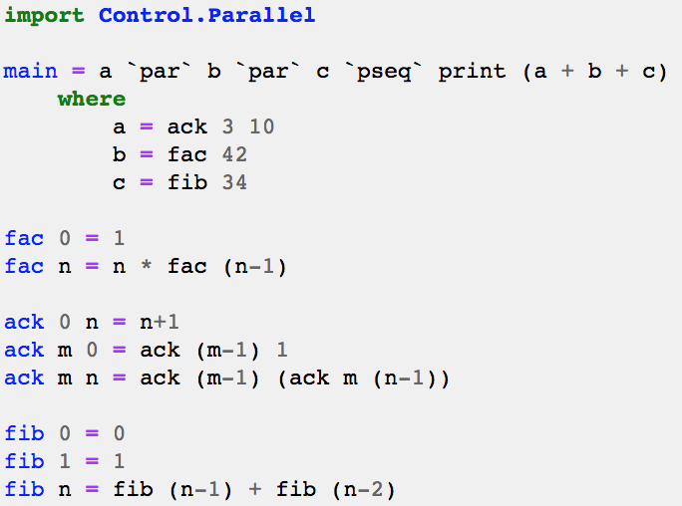
Example of Haskell
Notes:
Factorial – example, fac(4) = 24
Ackerman – classic example of recursion
Fibonacci – example, fib(0) = 0, 1, 1, 2, 3, 5, 8, 13, 21, 34

Slide 10
Logical
Based on predicate calculus
Statements are express as facts and rules
Prolog uses recursion
Examples of functional languages are Alma-0 and Prolog
Notes:
Statements express facts and rules about problems within a system of formal logic
Prolog uses the process called recursion in order to allow for a set of instructions to occur multiple times until a specific condition is met
The process in which a function calls itself directly or indirectly

Slide 11
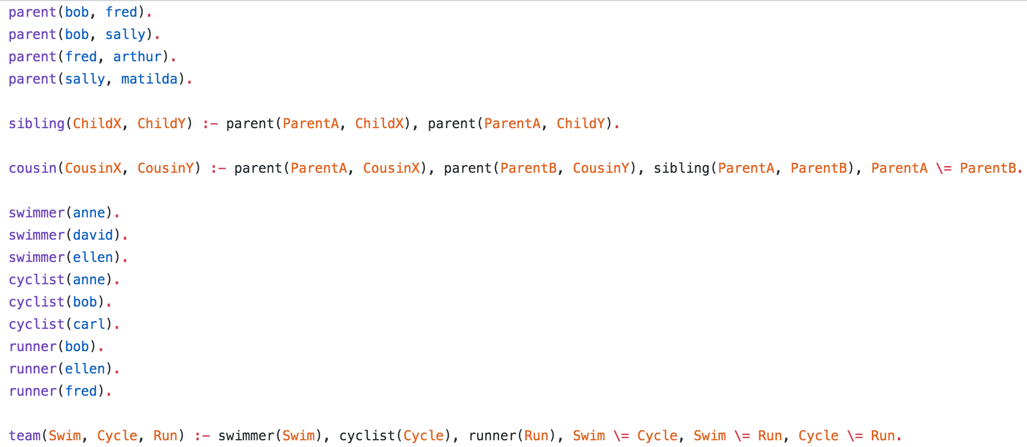
Example of Prolog

Slide 12
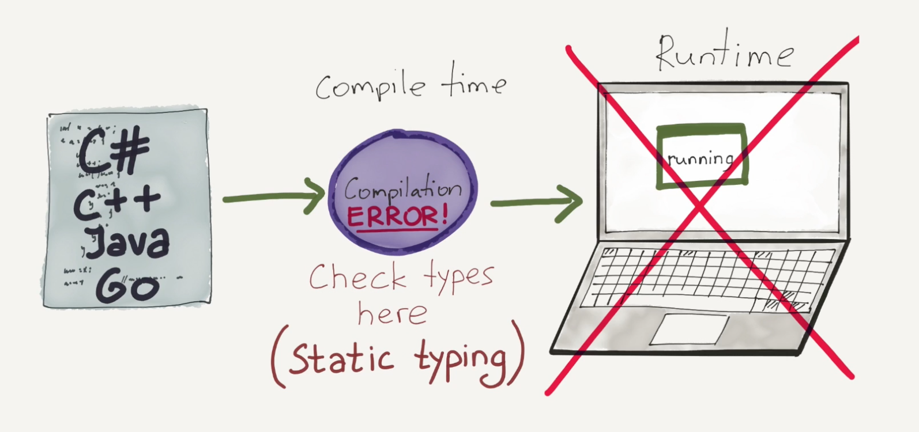
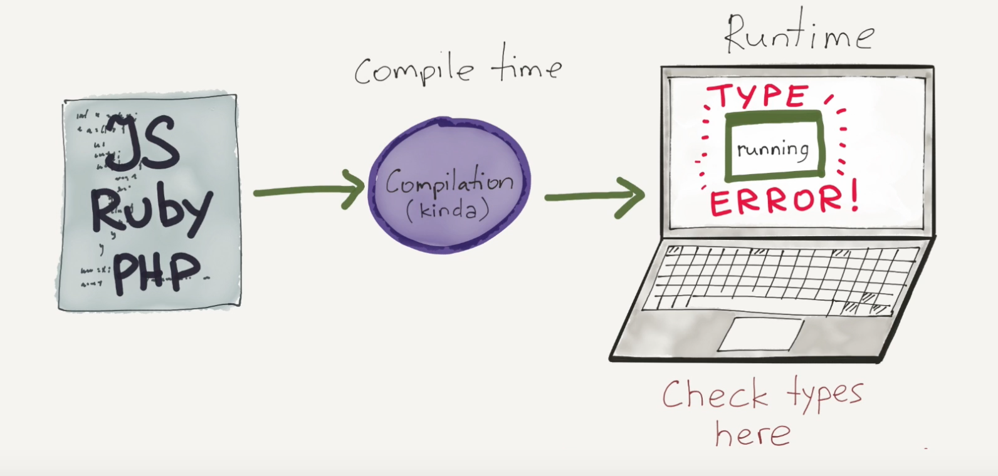
Additional dimensions
Strong typed vs weak typed
Static typed vs dynamic typed
Notes:
Python example:
data = 10; data = “Hello World!”;
Java example:
int data; data = 50; data = “Hello World!”;
Advantages of statically typed languages:
A large class of errors are caught in the early stage of development process.
Static typing usually results in compiled code that executes more quickly because when the compiler knows the exact data types that are in use – use less memory and optimised
Advantages of dynamically typed languages:
Implementations of dynamically type-checked languages generally associate each run time object with a type tag (i.e., a reference to a type) containing its type information.
Strong/weak type is about show strictly are distinguished – JavaScript and C# use the keyword var
Static/dynamic type is about when type information is acquired either at compile time or at runtime
Static checks the types then runs the program – C#, C++, Java and Go are statically typed language
Dynamic runs the programs then checks the types – JavaScript, Ruby and PHP are dynamically typed languages

Slide 13
Syntax
A set of rules
Distinguished into three levels
Words
Phrases
Context
Examples include:
C-family: for (int i = 0; i < 5; i++)
Pascal: for i := 0 to 5
Ruby: for i in 0..5

Slide 14
Reasons why you should
Worlds fastest growing programming language
An imperative/OO programming language with functional features
Solve problems in less time with fewer lines of code
Compiles to byte code, then interpreted
High level language – garbage collection
Cross-platform – runs on Windows, MacOS and Linux
Huge community
Large ecosystem – variety of tools and libraries

Slide 15
Python: imperative syntax
Use # for single line comments and ‘’’ for multi-line comments
No semi-colons at the end of statements
Use indentation for code blocks
Tabs or spaces – convention is one tab and four spaces

Slide 16
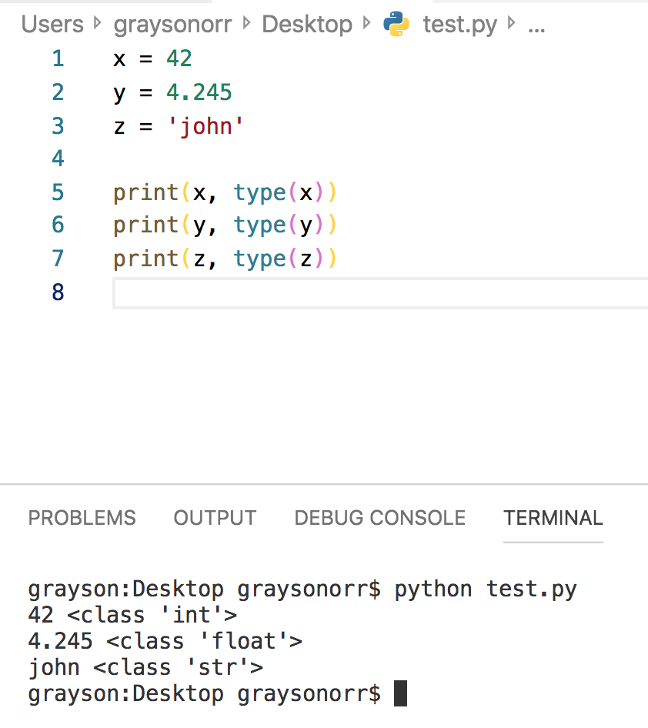
Python: imperative syntax
Eight kinds of types supported including bool, int, string, etc
Types are not declared, they are inferred
Notes:
You can check a variable’s type by calling the built-in type method

Slide 17
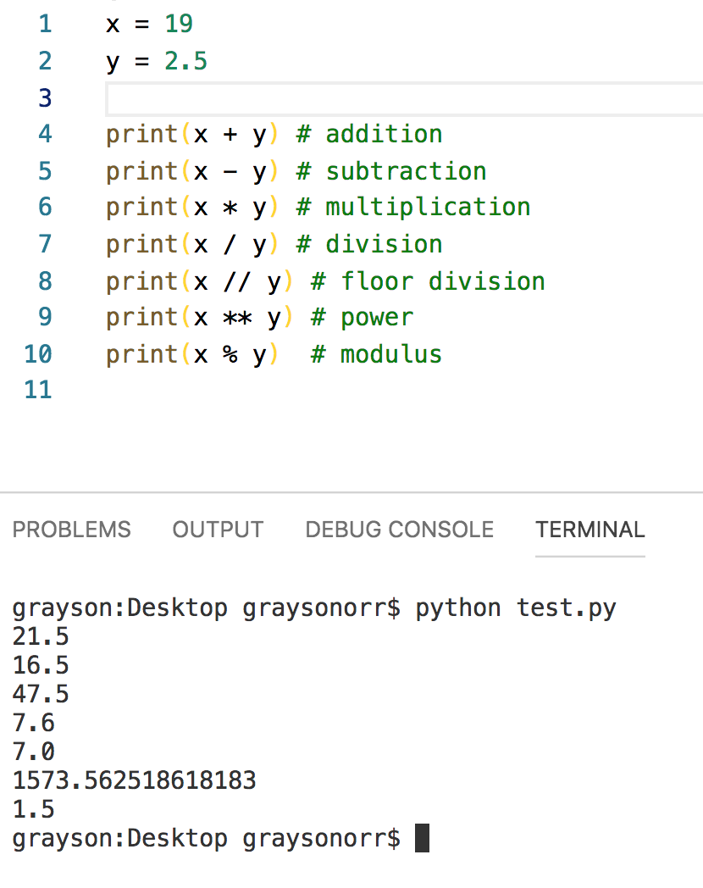
Python: imperative syntax
Supports basic operators including addition, subtraction, multiplication, etc

Slide 18
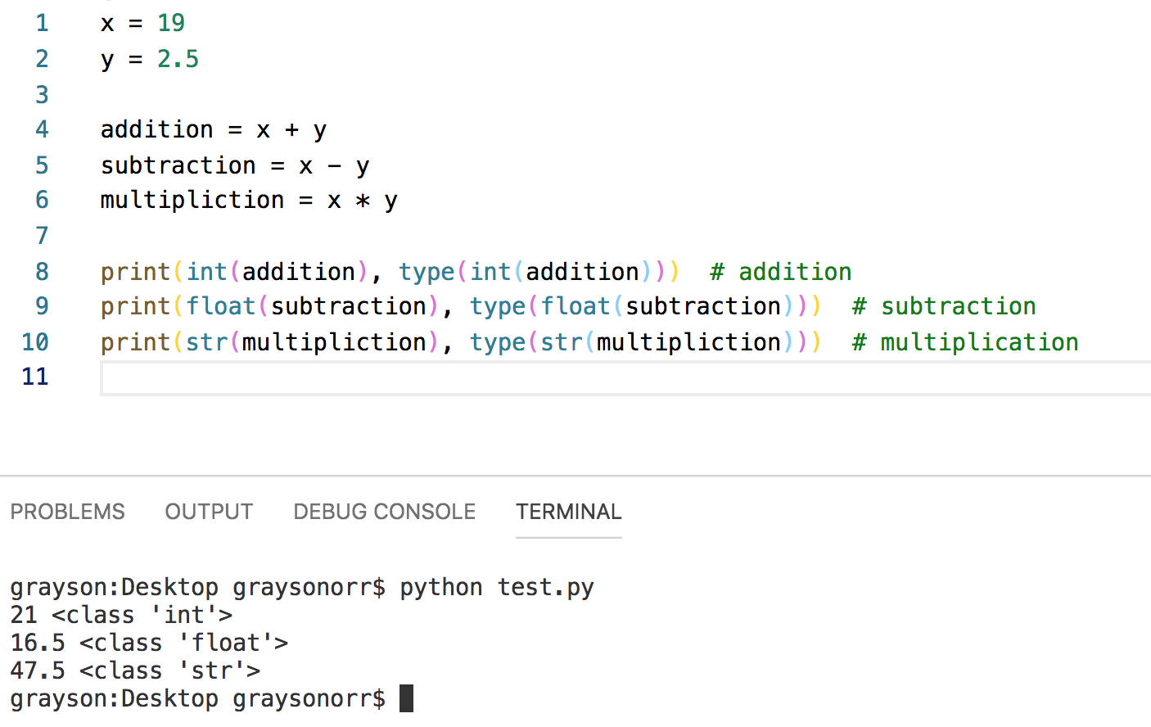
Python: imperative syntax
Supports casting

Slide 19
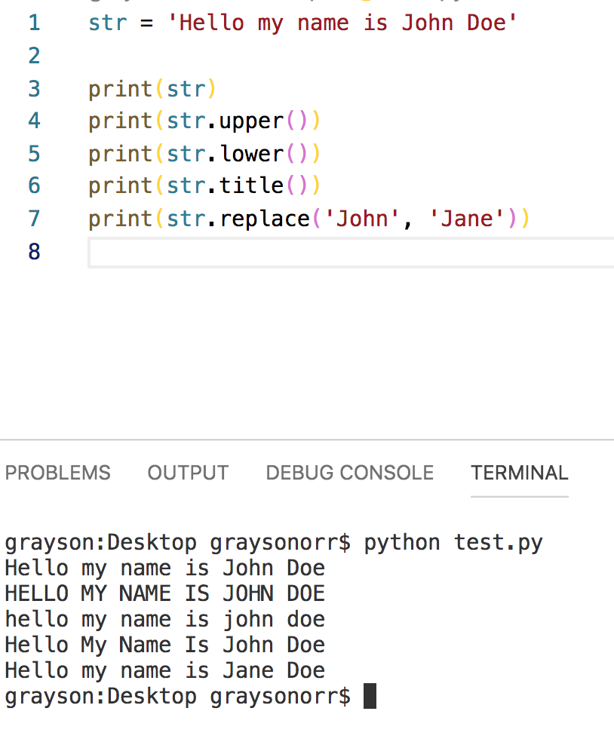
Python: imperative syntax
Assorted methods for strings including upper, lower, title and replace

Slide 20
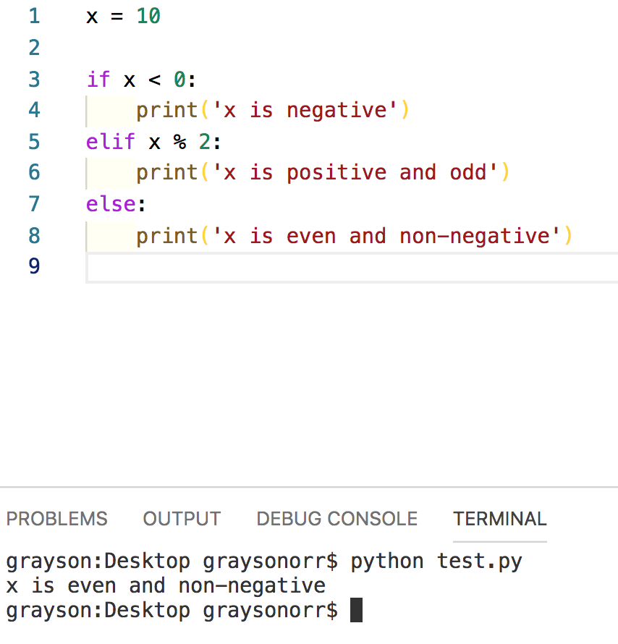
Python: imperative syntax
Flow of control – if, elif, else, for and while
Conditionals have a trailing : (colon)

Slide 21
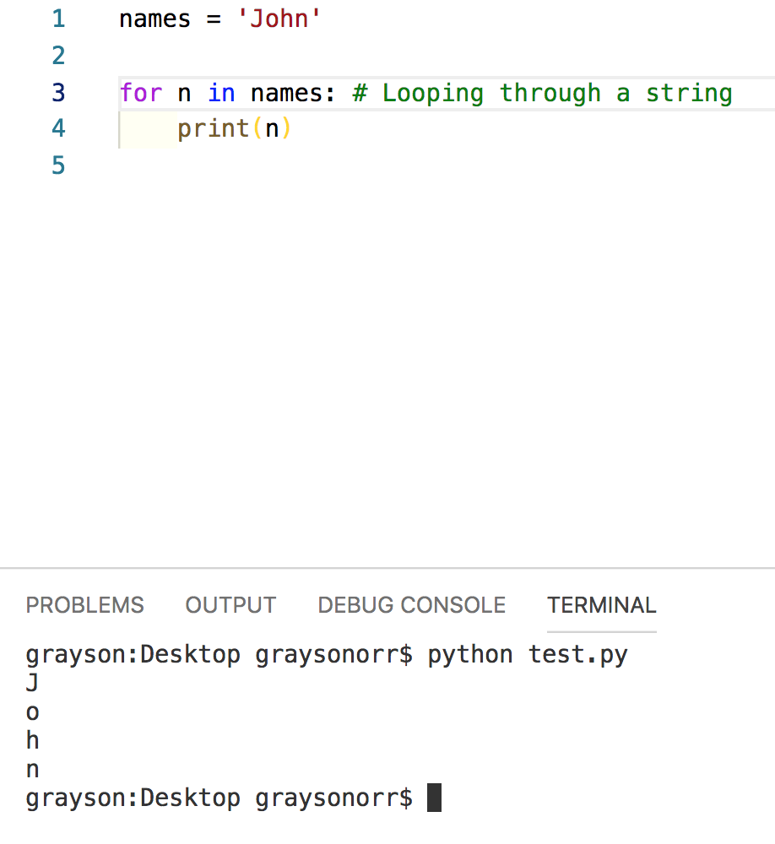
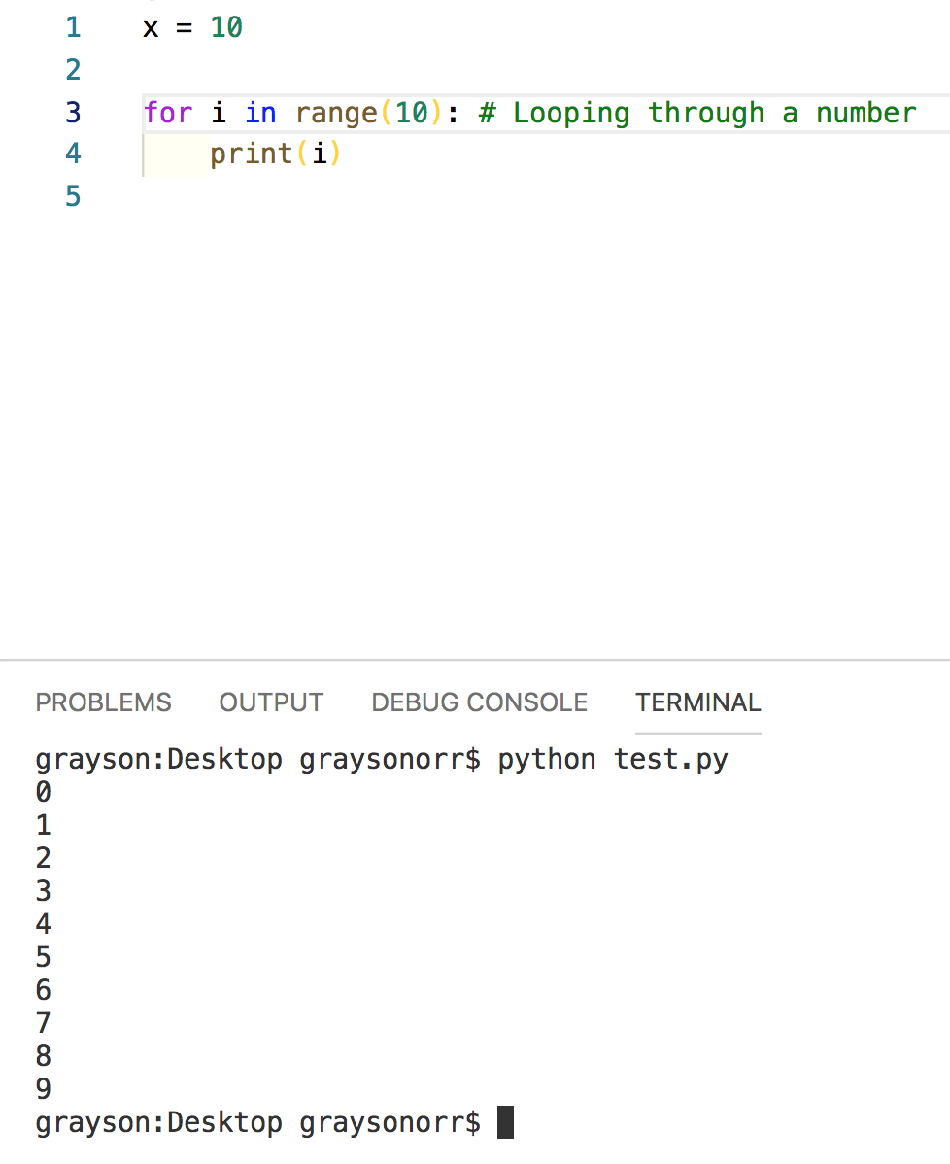
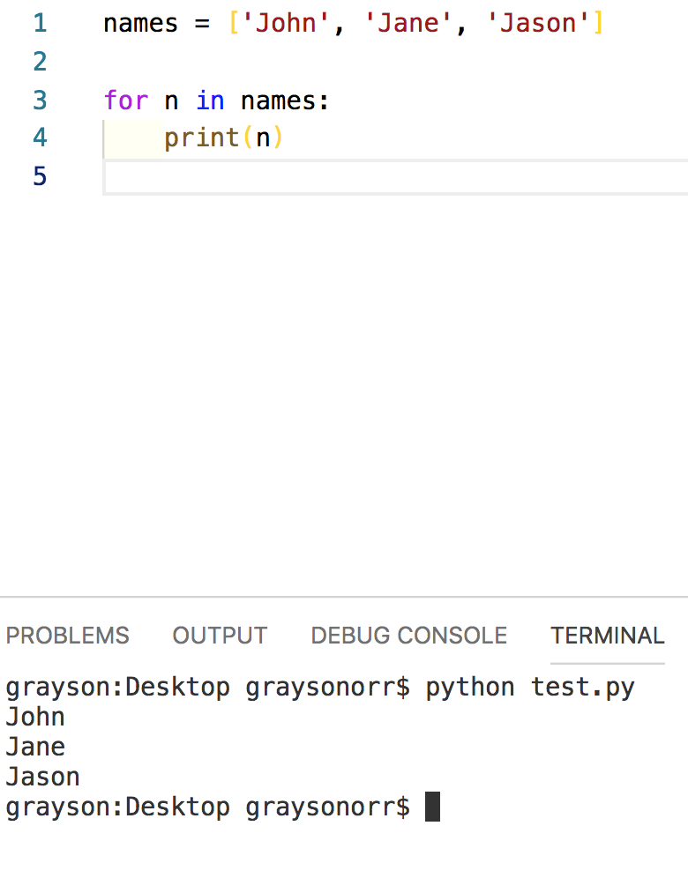
Python: imperative syntax
For-loops are much closer to foreach loops
Notes:
The basic loop over sequence of numbers functionality is achieved with the range function
Range also takes an additional argument called step which can be positive and negative
Three example on how we can use the for-loop in Python:
Looping through a string
Looping through a number/integer
Looping through an array of strings

Slide 22
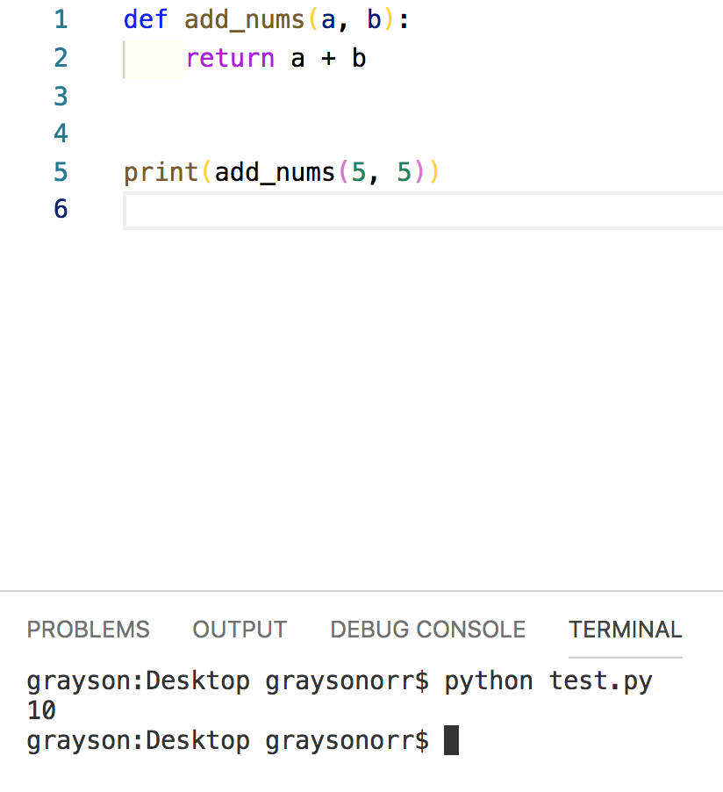
Python: imperative syntax
Functions
No need for classes
Use the def keyword and trailing : (colon)
No need for types on input arguments

Slide 23
Practical
Time to do some coding…

